Slide 2



A
F
FAST
T
LEARN
S
PRESENTATION
Satya
Avik
Bimal
Vijay
Deepan
Shambu
Piyali
Riya

Slide 3



Kislay
Sumit

Slide 4






















































Presented
By
Kislay
KISLAY KUMAR SINGH
&
SUMIT MANDAL
Sumit

Slide 5
CONTENTS
Problem Statement
Solution – E - Learning Website
Development of Fast Learn Website
Feasibility Analysis
Requirement Analysis
Design
Coding
Testing
Screenshots of Fast Learn Website

Slide 6
Problem Statement
FAST LEARN
?
?

Slide 7

Problem Statement
Fast Learn is a distance learning institute in US with its
head offices located in New York and several branch
offices located across the world.
Problems in current system :-
Non availability of faculty on phone.
Resolving queries over phone is difficult.
Students have to visit center to collect
books, obtain information.
Searching students information, which are
maintained manually is time consuming.
?

Slide 8
Solution E-Learning Website
FAST LEARN
.
.

Slide 9


Solution – E-Learning Website
End Users of Website :
Students
Solution
Faculty
Administrator

Slide 10
Development of Fast Learn Website
FAST LEARN
-
-
-
-
-
-
-
-
3
-
-
2
1

Slide 11


5
STEPS
FOR CREATING
WEBSITE

Slide 12
1
3
5
Feasibility
Analysis
Design
Testing
2
4
Requirement
Analysis
Coding

Slide 13


1
1
Feasibility Analysis
FAST LEARN

Slide 14
Feasibility Analysis
Feasibility Analysis includes Project Requirements in terms of :
Input & Output Data
Schedule of Project
Available Software Tools
Available Hardware

Slide 15
2
Requirement Analysis
FAST LEARN

Slide 16
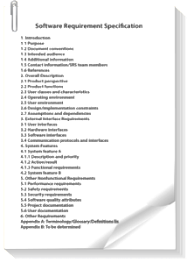
Requirement Analysis
Requirement Analysis includes gathering, analyzing, validating and specifying requirements. At the end of
this phase Software Requirement Specification (SRS) document is prepared.
S
R
S

Slide 17
Functionalities For Students
View Course Material
View Course Information
View Fee Structure
View Notices
Post Queries
Send Feedback
Change Password

Slide 18
Functionalities For Faculty
Answer Queries
View Course Material
Change Password

Slide 19
Functionalities For Administrator
Course Management
Student Management
Faculty Management
View Feedback
Search Information
Post Message
Change Password

Slide 20

3
Design
FAST LEARN

Slide 21
Design
Design includes translation of SRS document into
a logical structure that can be implemented in a programming language.
1
2
S
R
S
3
4
5

Slide 22
4
Coding
FAST LEARN

Slide 23
Coding
Coding includes implementation of the design document
into executable programming language code.
1
using System;
class coding
{
coding()
{
...
}
}
2
3
4
5

Slide 24
5
Testing
FAST LEARN

Slide 25
Testing
Testing includes detection of errors in the project.
using System;
class coding
{
coding
{
...
}
}
using System;
class coding
{
coding
{
...
}
}

Slide 26
FAST LEARN WEBSITE
SCREENSHOTS

Slide 27
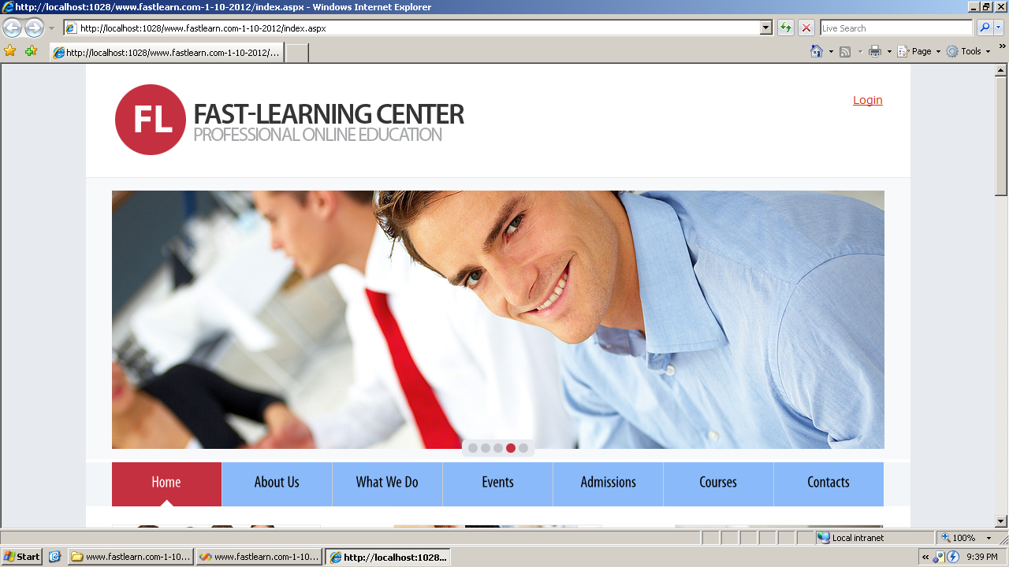

Slide 28
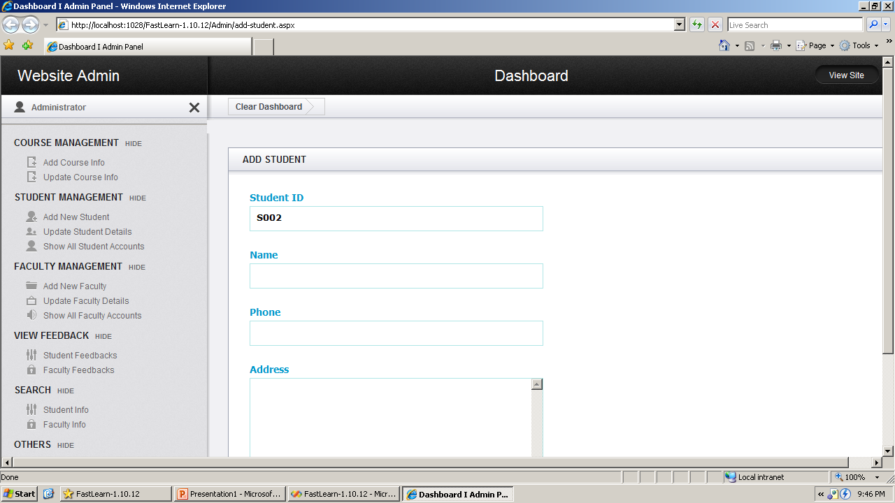

Slide 29
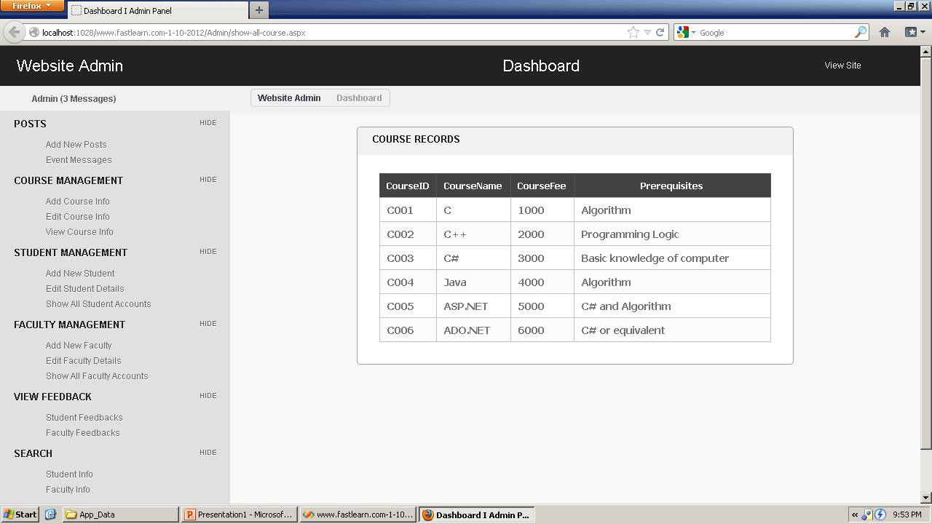

Slide 30
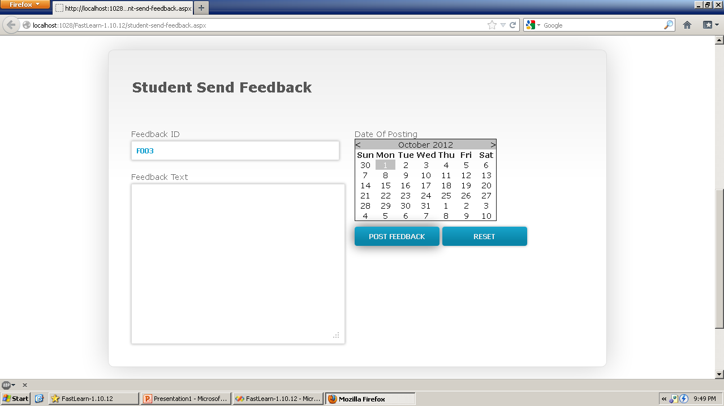

Slide 31
Conclusion
To create dynamic websites with proper functioning many languages and tools can be used like we have used asp .net web application framework, C# for coding, html, css and jquery for developing the dynamic nature of the website.

Slide 32















Thank
You
Satya
Avik
Bimal
Vijay
Deepan
Shambu
Piyali
Riya

